Slide 1




Introduction to RNA-seq
Prof Jun Wang
Centre for Cancer Evolution
2025/2026

Slide 2
Content
RNA sequencing (RNA-seq)
- bulk RNA-seq
- how to do RNA-seq and what can we do with it?
Single cell RNA-seq (scRNA-seq)
- how to do scRNAseq
- what can it be used for?

Slide 3
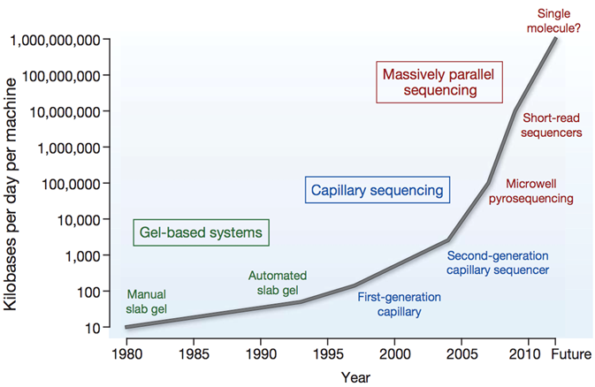
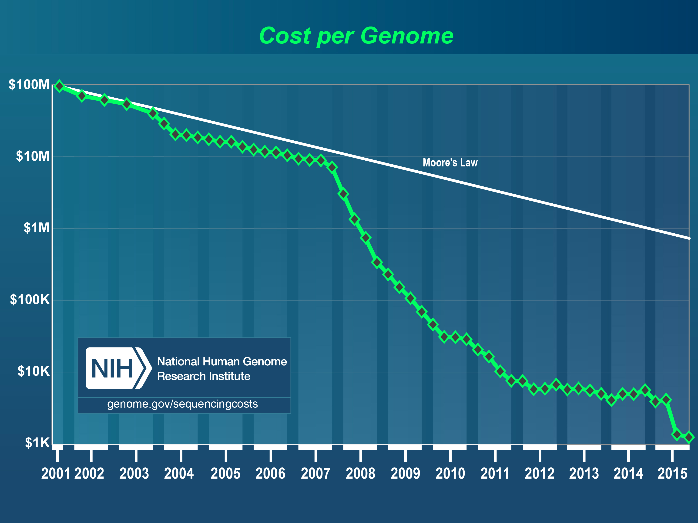
Next-generation sequencing (NGS)
Human Genome Project - $3 billion project, started early 90’s, which took 15 years to complete
Now, we can sequence the whole human genome in 24 hours in the cost of $1K

Slide 4

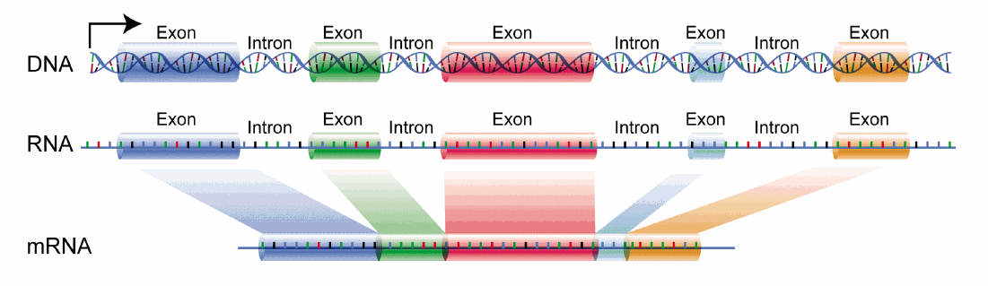
NGS techniques
3-billion base pairs
Whole genome sequenceing (WGS)
To capture exons only
Whole exome sequencing (WES)
To sequence mRNA only
RNA-seq

Slide 5
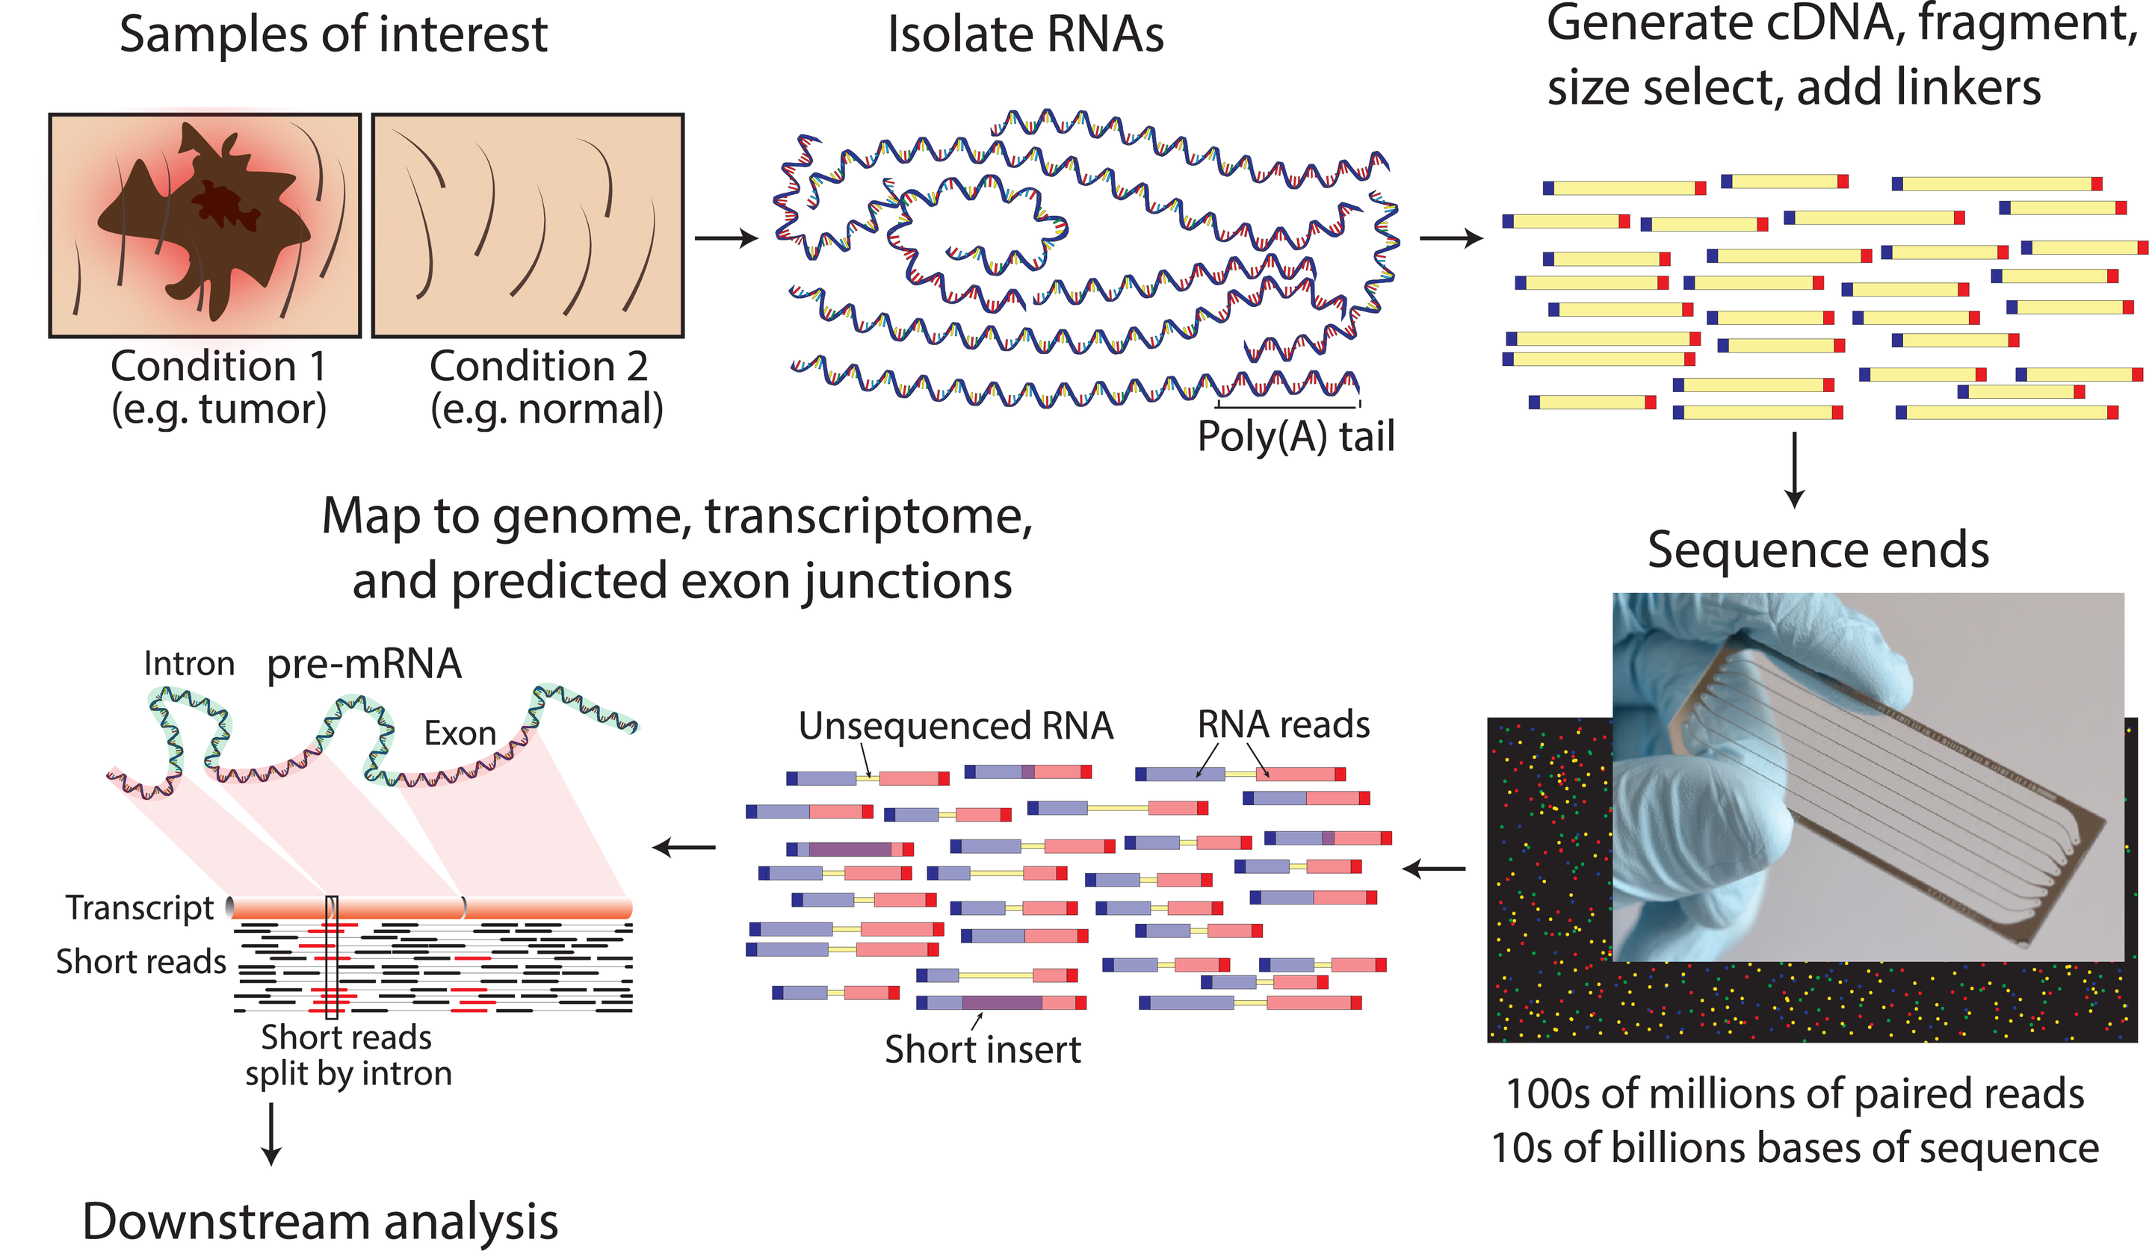
Bulk RNA-seq data generation
Poly-A selection vs. Ribosome depletion
Griffith et al. PLOS Computational Biology

Slide 6
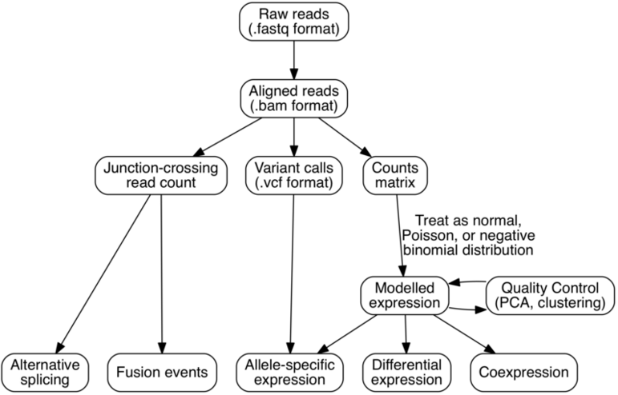
RNA-seq data analysis and application
Sequence alignment
Splicing analysis
Gene fusion
Expression analysis
Novel transcripts
Non-coding RNAs

Slide 7
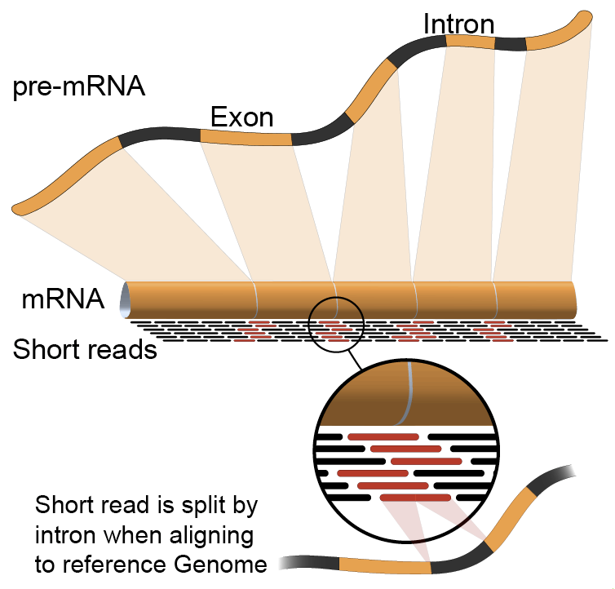
Short reads sequence alignment
Align short sequence reads to the reference transcriptome and genome first

Slide 8
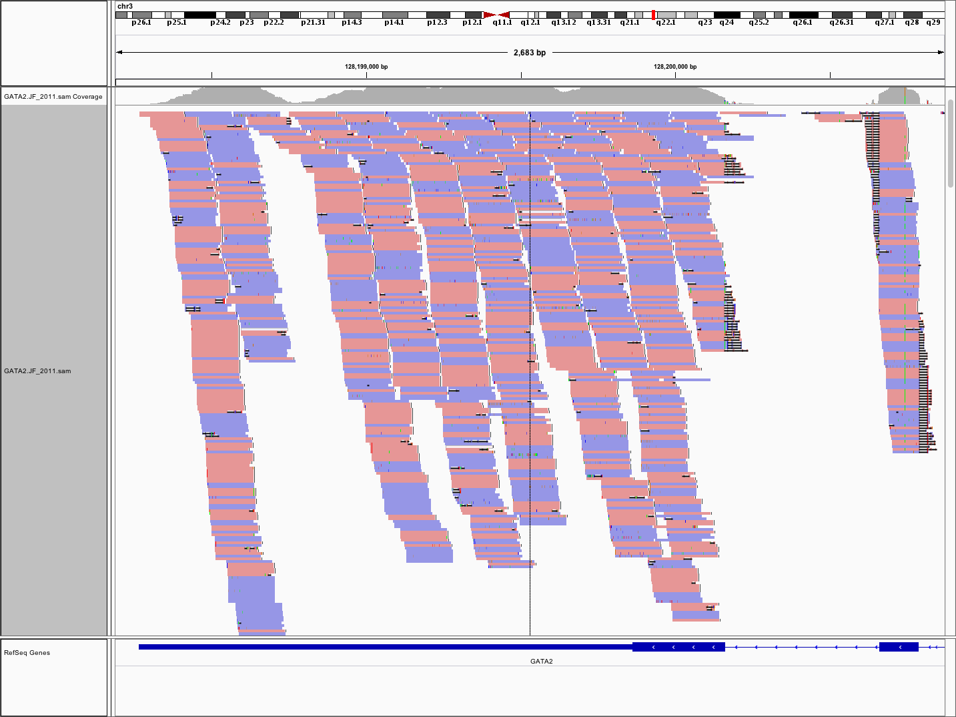
Reads mapping to exons
IGVtools to view the alignment

Slide 9
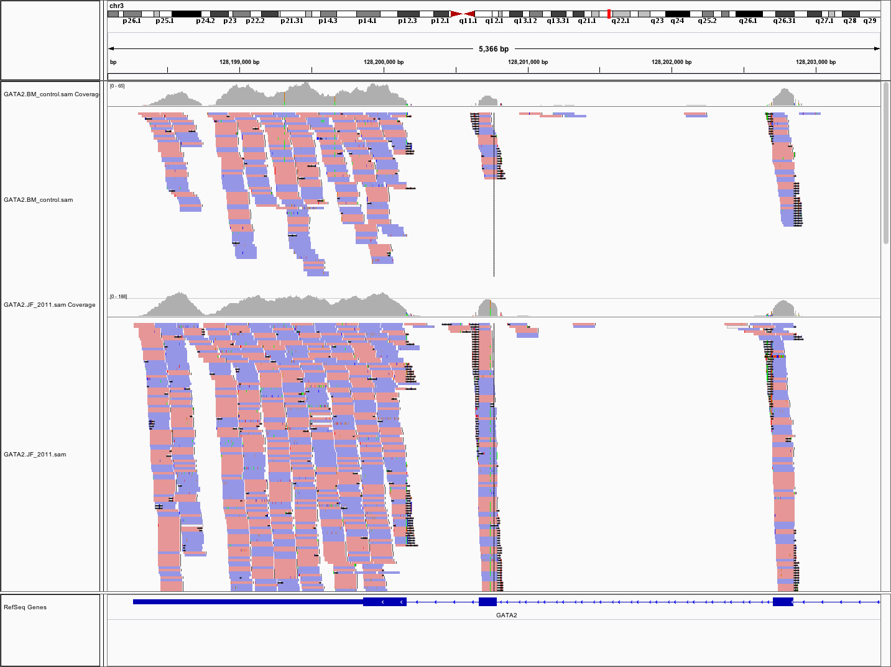
Expression analysis
By comparing disease versus control, we can perform differential expression analysis and identify up- or down-regulated genes
Normal
Tumour

Slide 10
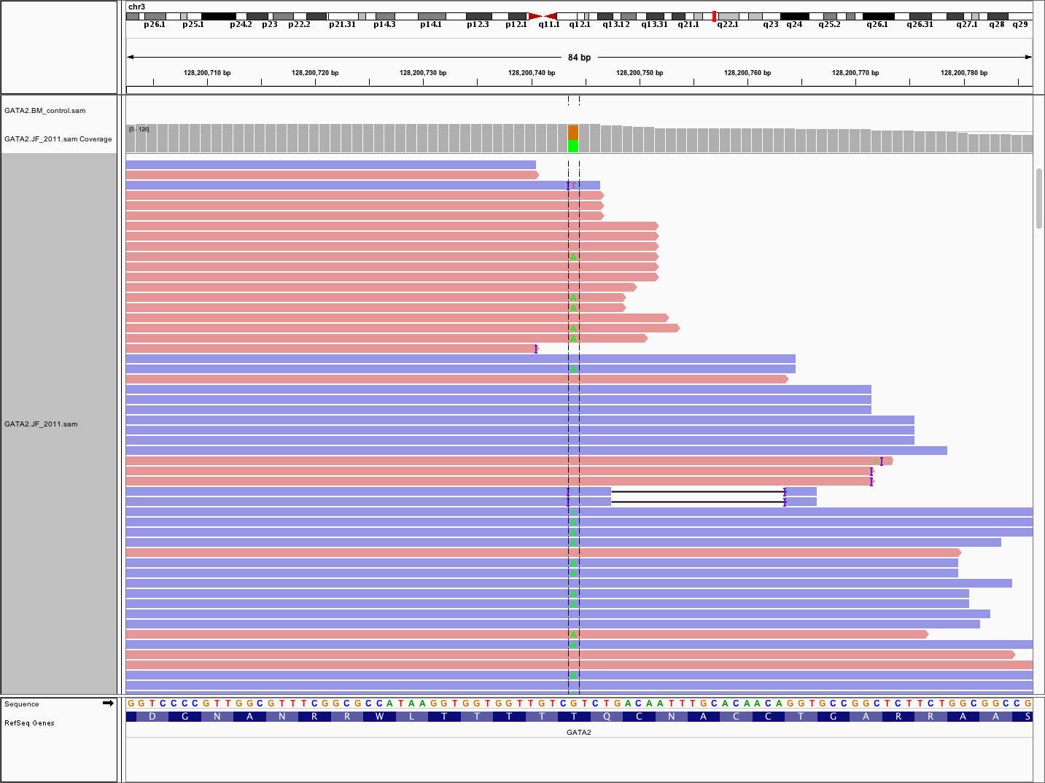
Variant identification
In this case, it looks like bi-allelic expression
At exon 5, chr3:128200744G>A; p.Thr354Met
In addition to simple variant identification, we can also detect allelic-specific expression

Slide 11
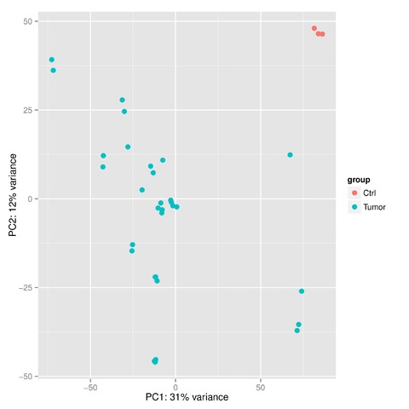
PCA and clustering
Principle component analysis (PCA) and clustering offer an overview how well samples from different biological groups are clustered – how similar or different they are

Slide 12
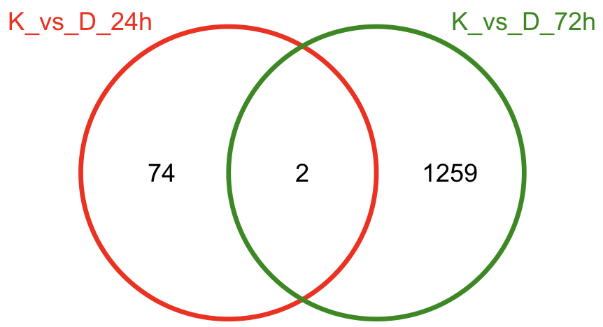
Differential expression
Significantly differentially expressed genes, false discovery rate (FDR) < 0.05
DE at the 24h point
DE at the 72h point

Slide 13
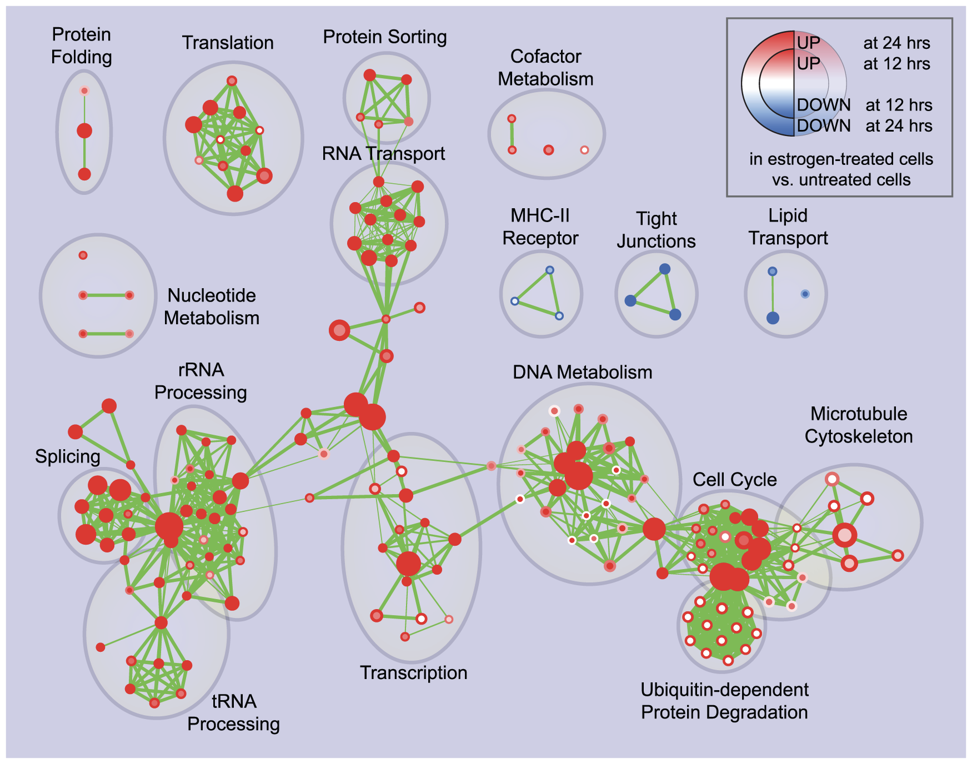
Pathway analysis
To detect overrepresented pathways and pathway enrichment for identified DE genes
- DAVID Functional Annotation Bioinformatics Microarray Analysis
- Ingenuity pathway analysis
Further visualise pathway enrichment using Enrichment Map (Merico et al. 2010)
Dysregulated pathways of
estrogen treatment of breast cancer cells at 24 hours of culture

Slide 14
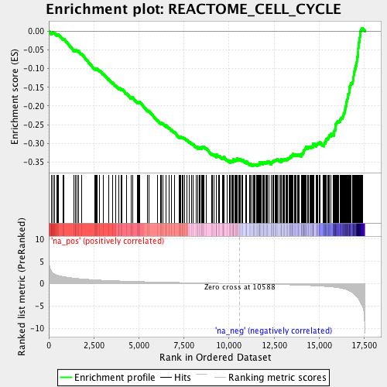
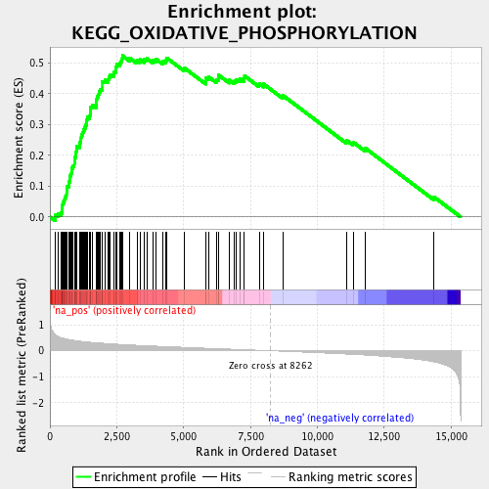
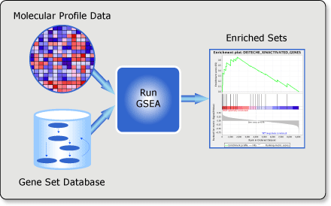
Pathway analysis
Instead of using significant DE genes only, expression changes of all filtered genes can be use to infer significantly altered pathways
- Gene set enrichment analysis (GSEA) tool (Subramanian et al. 2005)
Cell cycle – downregulated in the treated compared to control
Oxidative phosphorylation – upregulated in the treated compared to control

Slide 15
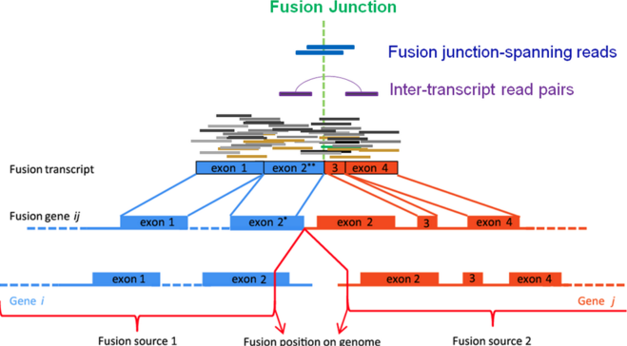
Identification of gene fusion events
TopHat-fusion (Kim et al. 2011)
SOAPfusion (Lam et al. 2008)

Slide 16
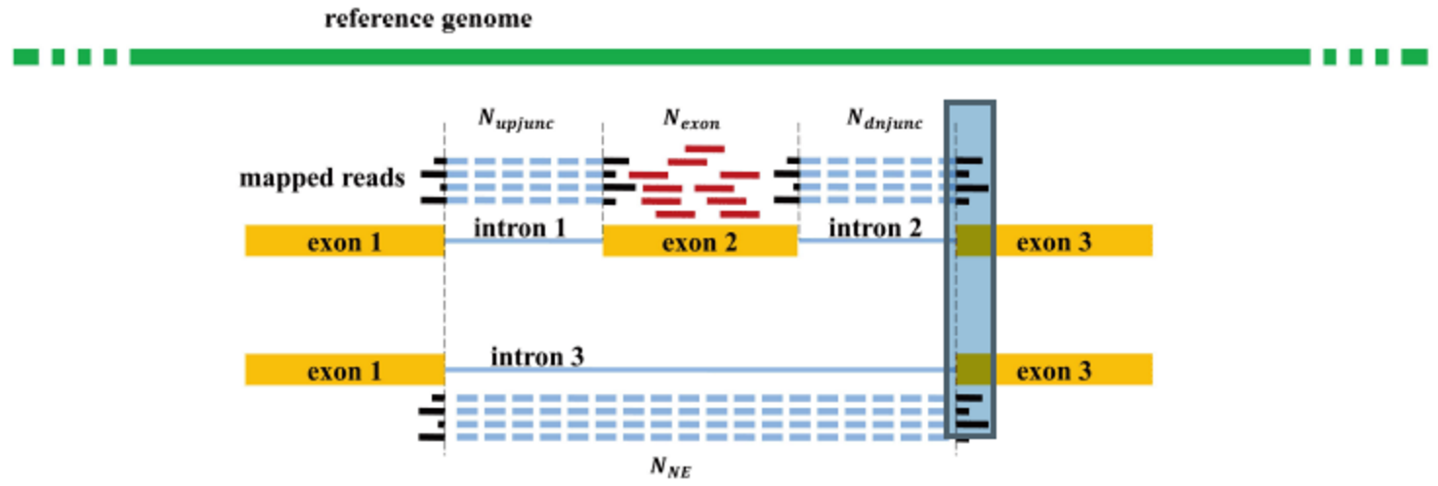
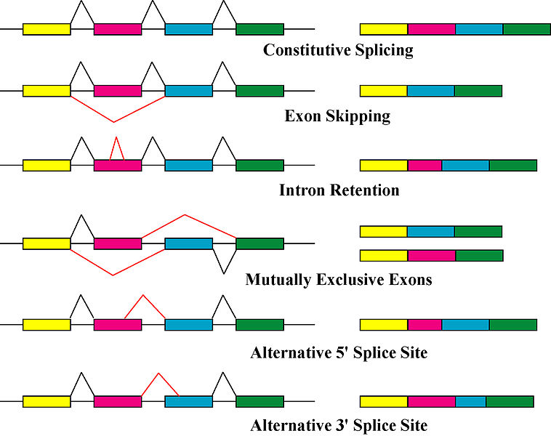
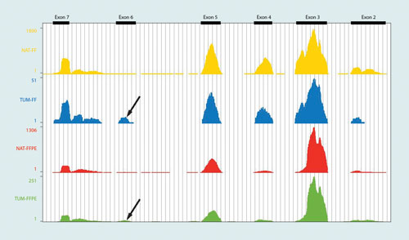
Alternative splicing
By looking at the reads coverage across exons and exon-intron junctions, we can identify alternatively spliced variants and isoform-level expression

Slide 17
Coexpression
Some genes, especially those directly or indirectly interacted, tend to be expressed together, positively or negatively
Using breast cancer patient RNA-seq data via CBioportal

Slide 18
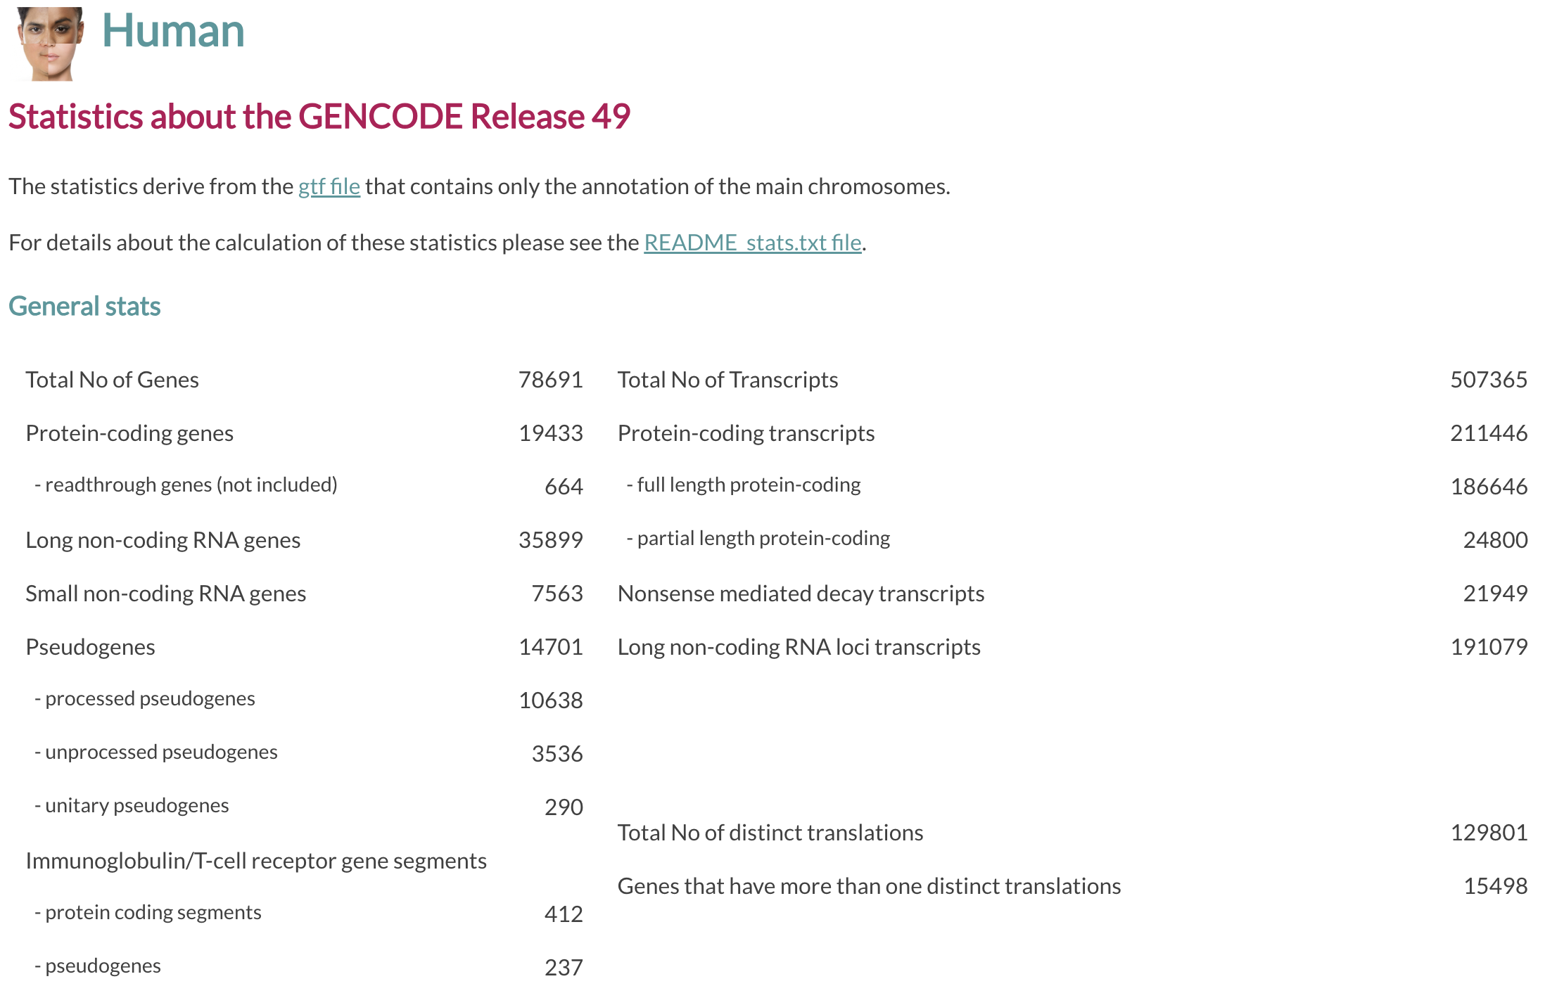
Long noncoding RNAs (LncRNA)

Slide 19
What are lncRNAs?
lncRNAs > 200nt length
Some are conserved sequences, while some are poorly conserved
Restricted expression
Low expression
DNA, RNA and protein interactions
Gene regulation & chromatin dynamics
DNA - lncRNA
RNA - lncRNA
Protein - lncRNA
Atianand et al., Annual review of immunology (2017)
Ribosome depletion to capture all lncRNAs
Functional classification
Intronic
Enhancer
Promoter-associated
Genic
Intergenic
TSS
TSS
Enhancer
Gene 1
Intron
Gene 1
Gene 2
TSS
Antisense
Intergenic
Enhancer
Natural Antisense Transcripts
Notes:
1. LncRNAs are defined as ncRNAs that are greater than 200nt in length.
2. They comprise majority of non-coding genome, with over 16,000 lncRNAs identified in human genome.
Properties
3. Some properties of these lncRNAs are, they have conserved sequences
4. They also exhibit tissue-restricted, developmental- and temporal-specific expression patterns
LncRNAs are lowly expressed when compared to protein coding genes
Function
6. In terms of function, lncRNAs can function via DNA, RNA and protein interactions to affect gene regulation & chromatin dynamics
7. Can be functional classified as bidirectional, intronic, intergenic, enhancer, genic, intronic, promoter associated, intergenic and NATs
8. LncRNAs are implicated in vital biological processes such as development, differentiation, immunity and diseases such as cancer.
9. However, their biological function of lncRNAs is still poorly understood.
10. Increasing work is underway to characterise lncRNAs in various cancers and we sought to do this in the HGS.
Atianand, M.K., Caffrey, D.R. and Fitzgerald, K.A., 2017. Immunobiology of long noncoding RNAs. Annual review of immunology, 35, pp.177-198.

Slide 20
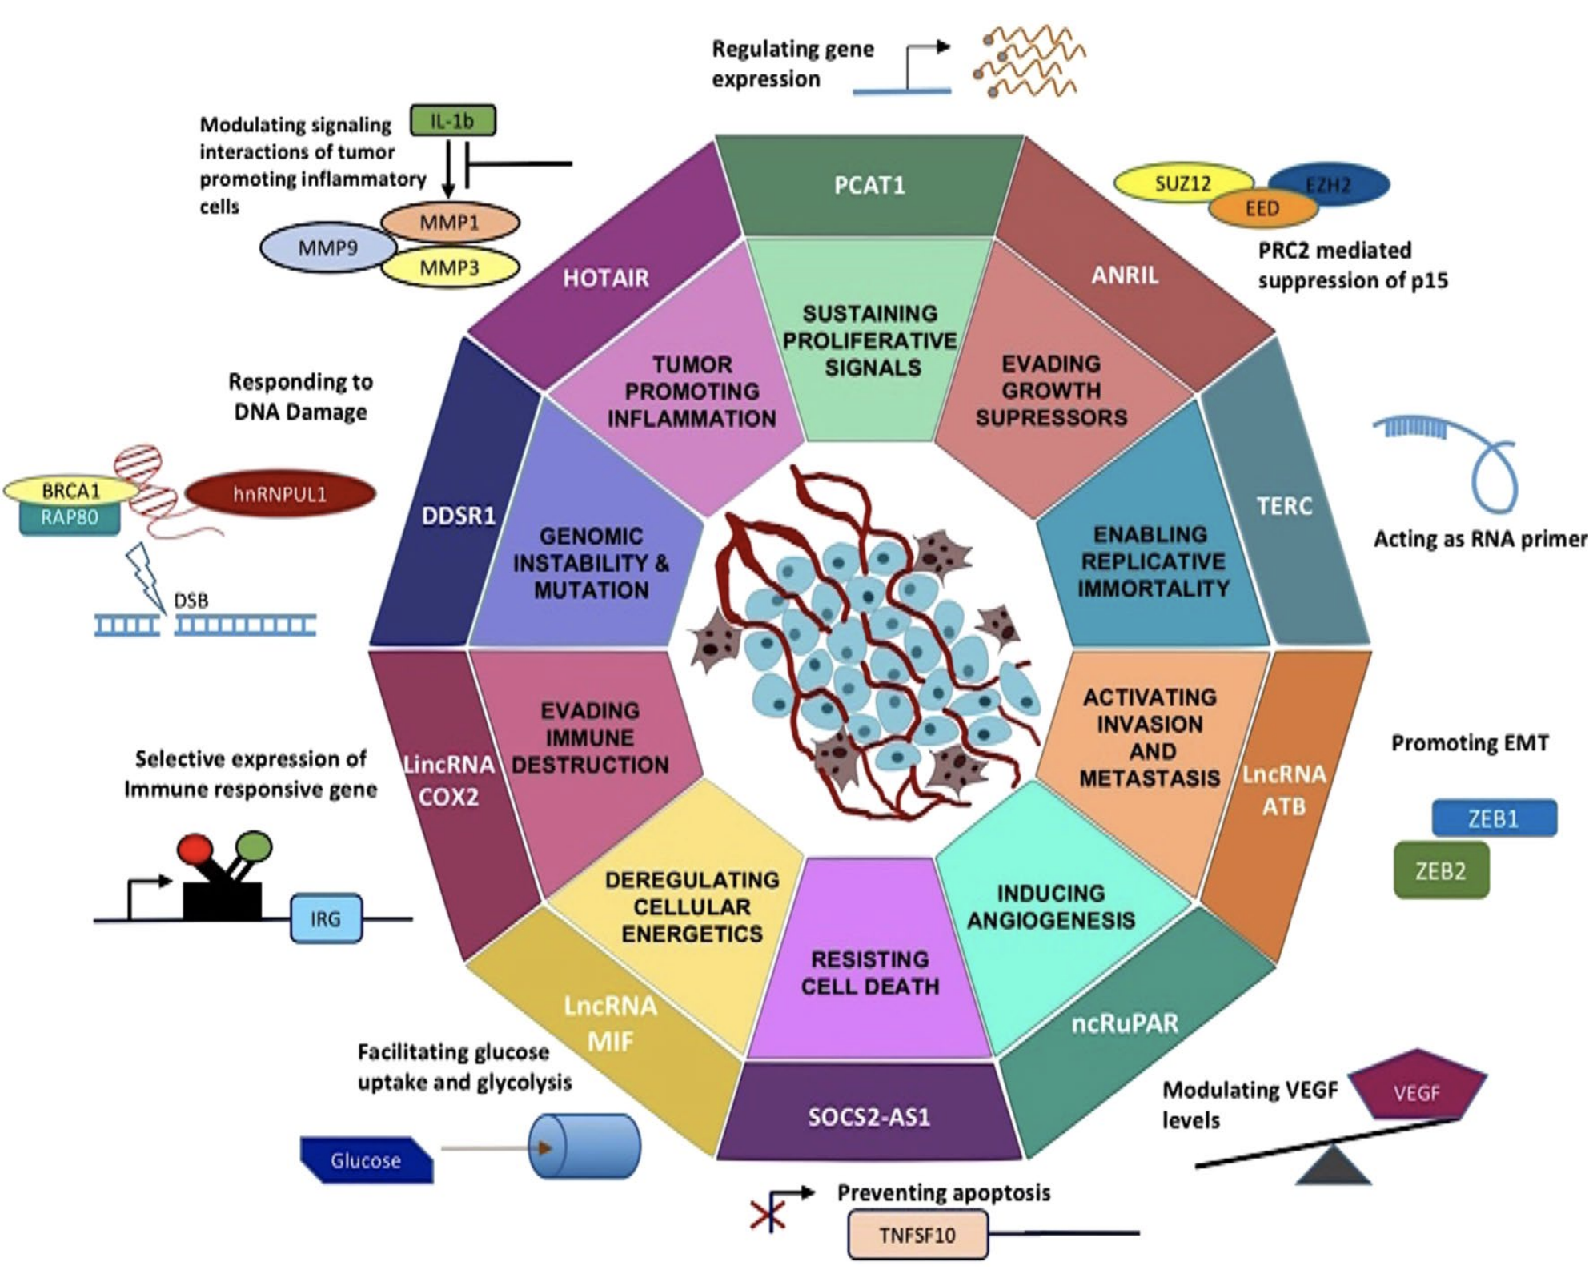
LncRNAs and hallmarks of cancer
Rao et al. Mol Biol Rep 2017

Slide 21
LncRNA example: MALAT1
High level of conservation
High level of regulatory activities
High level of transcription
A lncRNA associated with poor prognosis and metastasis in many tumours!

Slide 22
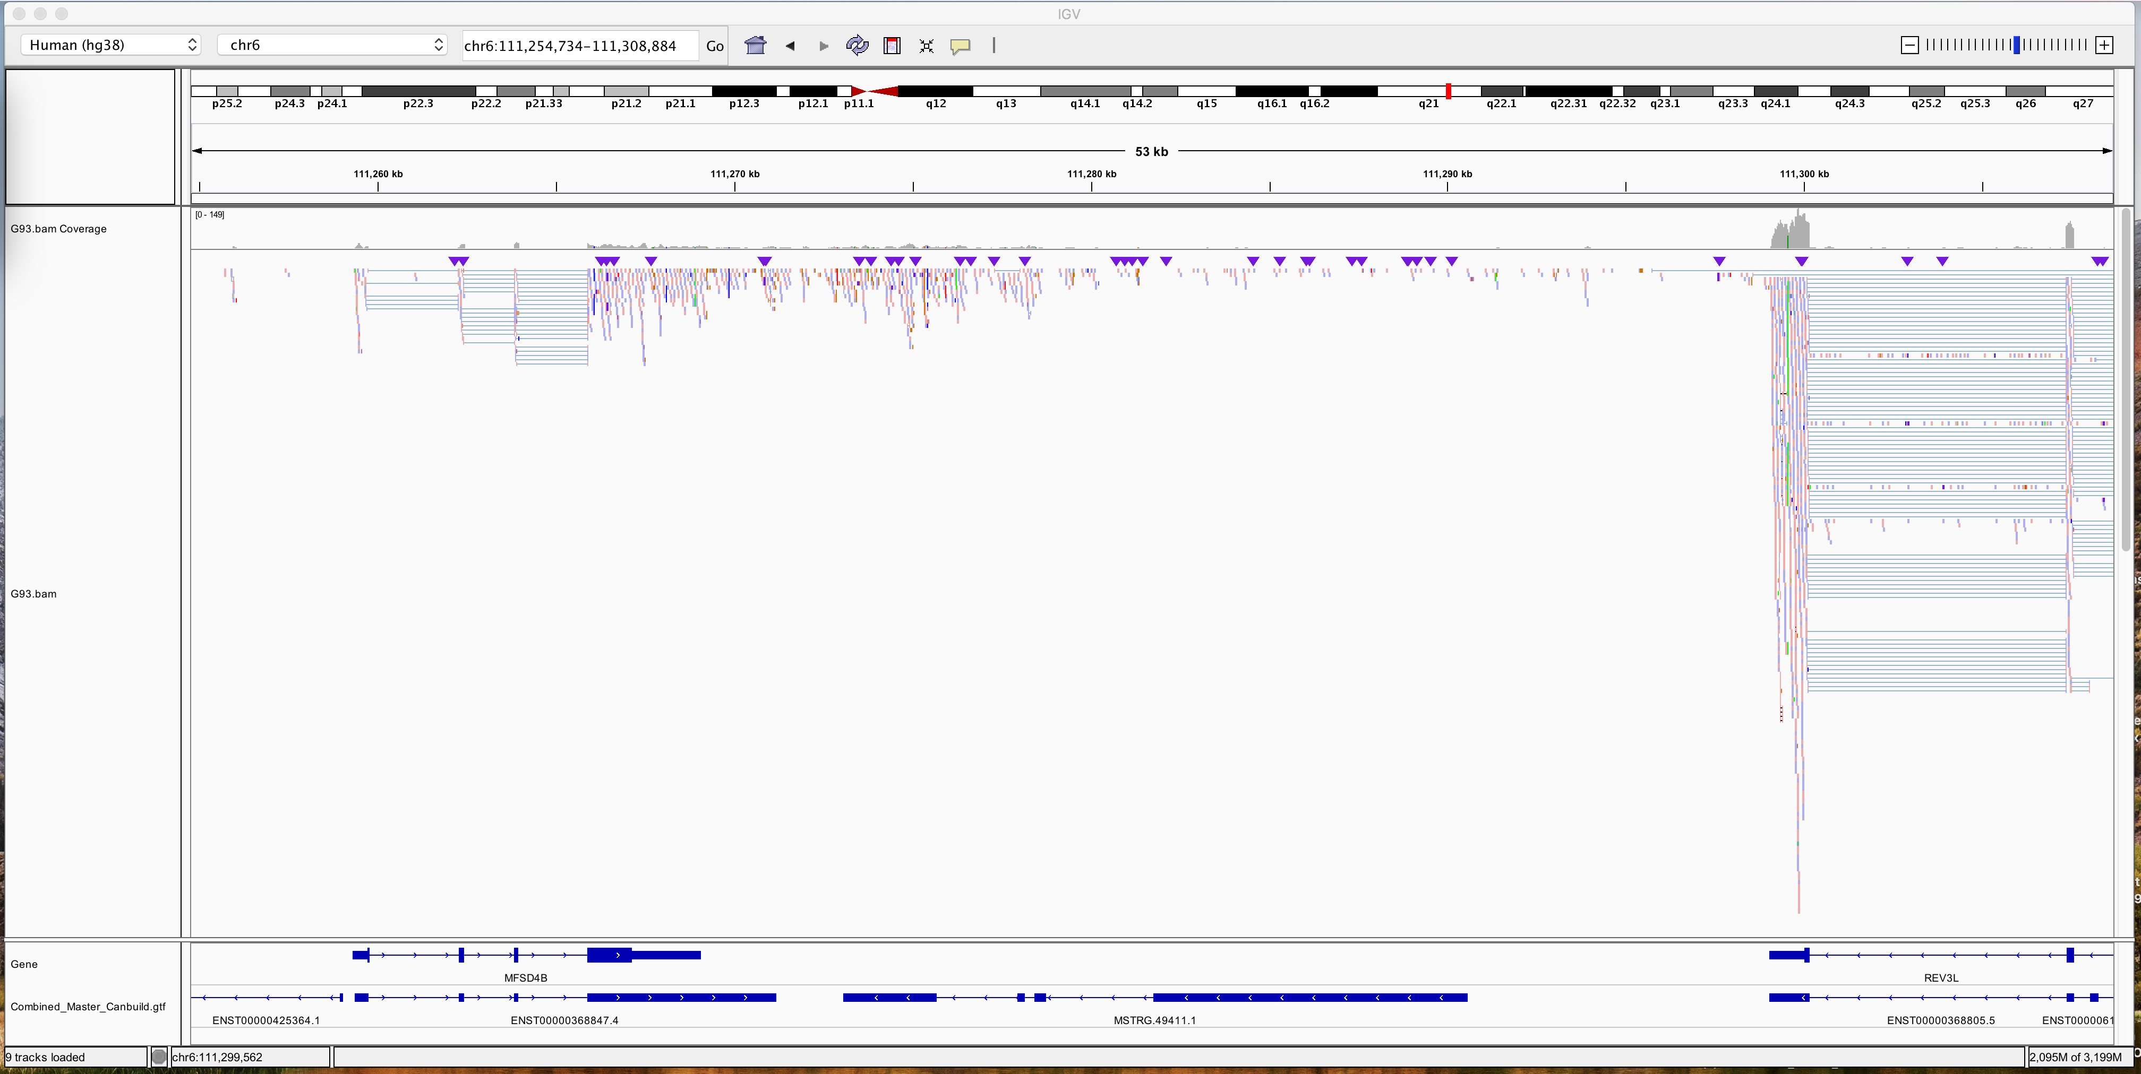
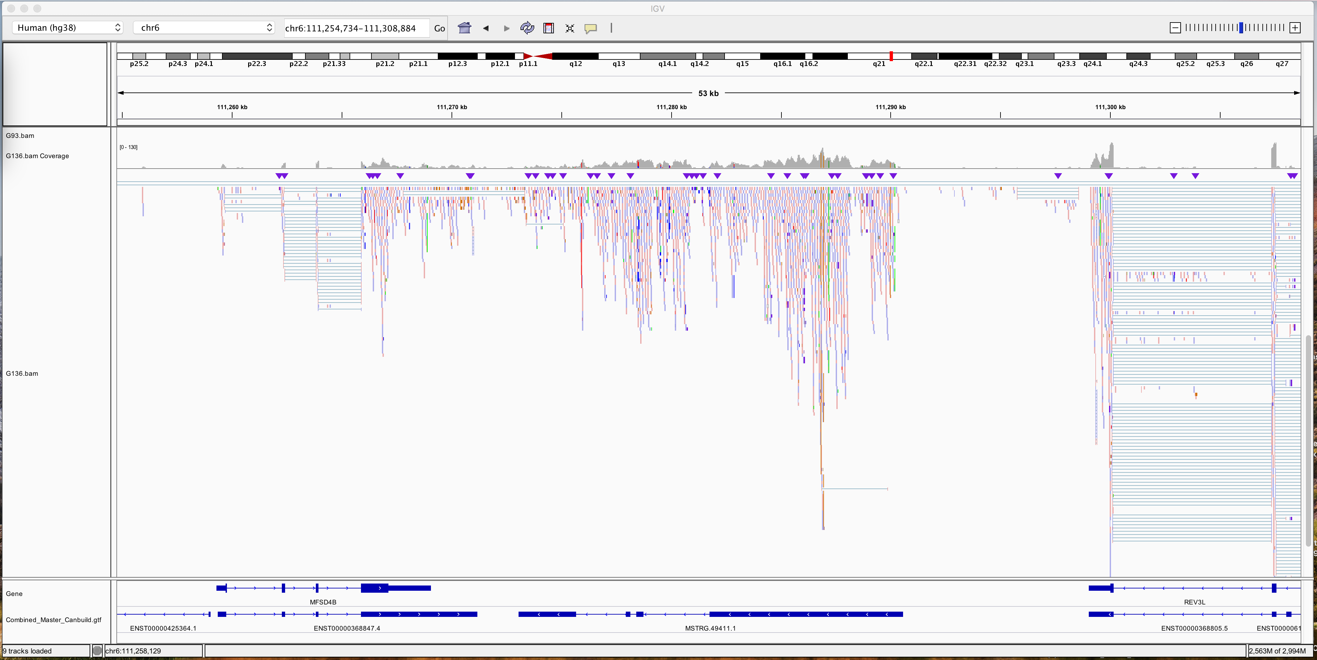
l_LNC14112, a novel lncRNA
Low disease
sample
High disease
sample
Reference transcriptome (hg38)
l_LNC14112
novel intergenic lncRNA?
Assembled supertranscriptome based on Discovery dataset
Barasa et al. unpublished

Slide 23
RNA-seq
RNA-seq, a powerful tool to identify
- differential expression
- alternative splicing
- gene fusion
- novel transcripts
- RNA-level sequence variants
- bi- or mono-allelic expression
- coexpression network
- many other molecular features, including lncRNAs

Slide 24
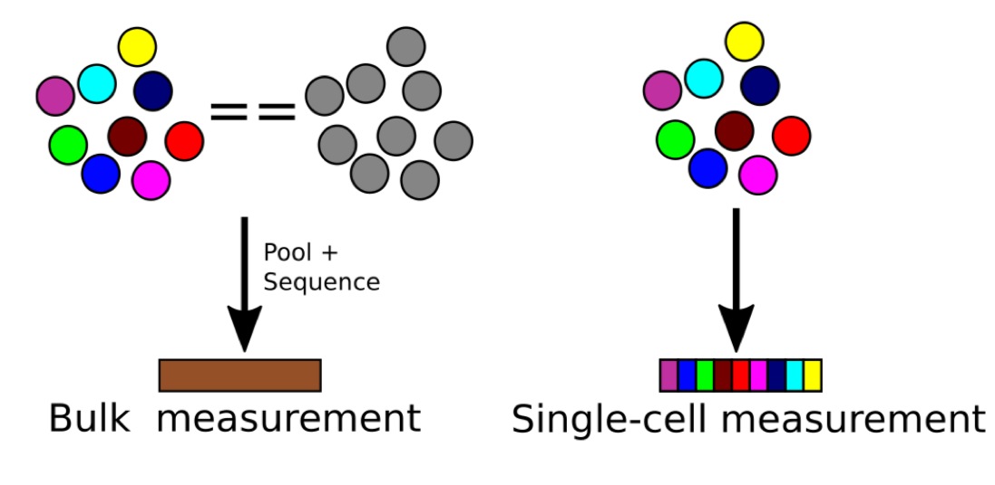
Single cell -omics
Can currently measure:
Transcriptome
Chromatin accessibility
Mutation & CNV
Methylation
Limited proteomics

Slide 25
ScRNA-seq workflow
Plate-based
droplet-based

Slide 26
General workflow – 10x
A usual 10x run setting: ~10,000 cells (5-8k usable cells), 50,000 reads per cell

Slide 27
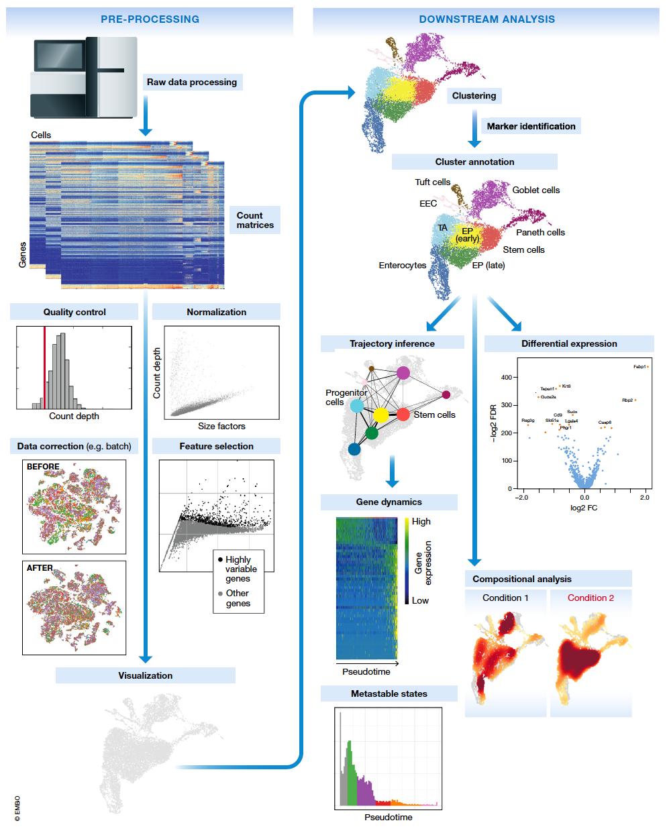
Schematic of a typical single-cell RNA-seq analysis workflow

Slide 28
Main applications using scRNA-seq in cancer
Study tumour microenvironment
- e.g., tumour infiltrating lymphocytes (B and T cells), macrophages and fibroblasts
Study tumour heterogeneity
- e.g., identify resistant clones of tumour cells, and trace tumour cell evolution

Slide 29
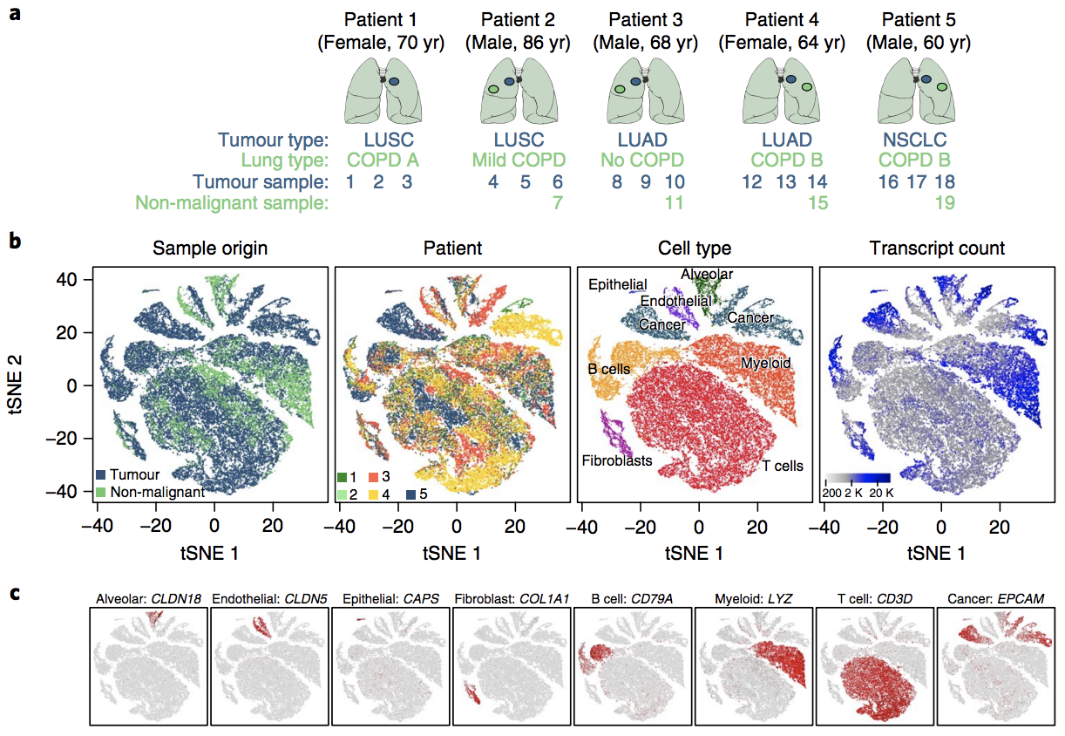
scRNA-seq example #1 - overview
Lambrechts et al. Nat Med 2018

Slide 30
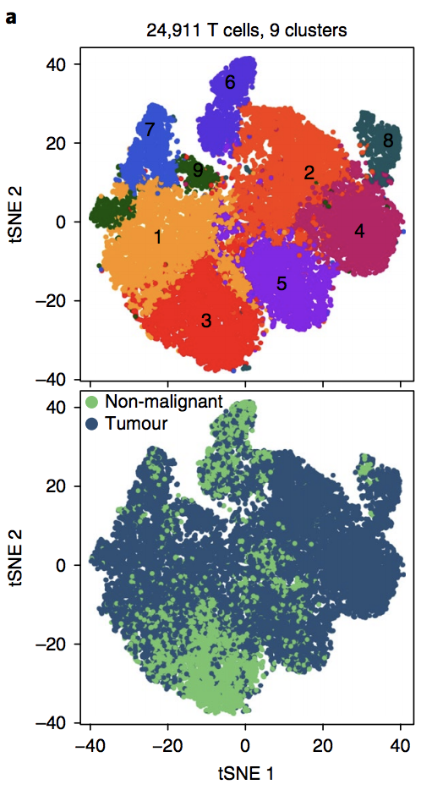
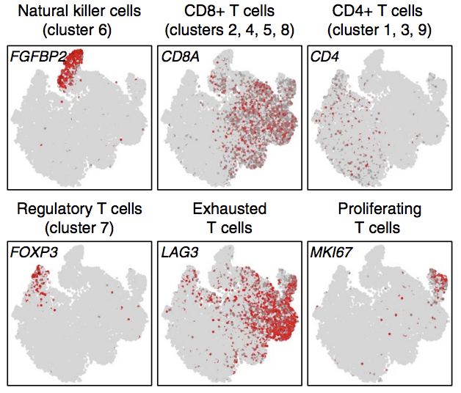
Sub-clustering of major cell types
T cells

Slide 31
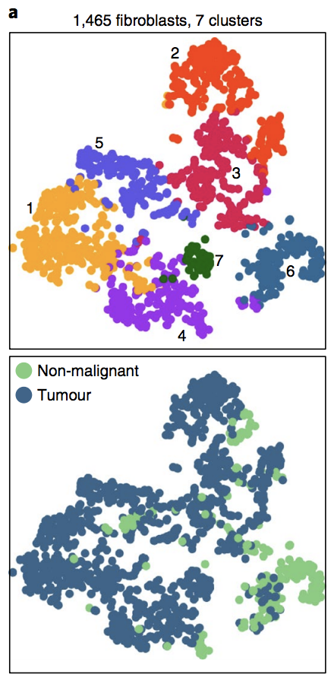
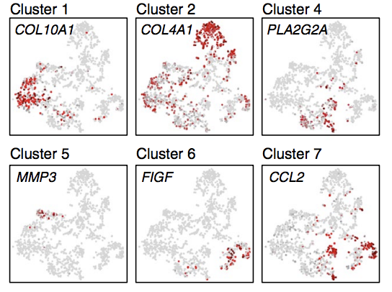
Sub-clustering of major cell types
Fibroblasts

Slide 32
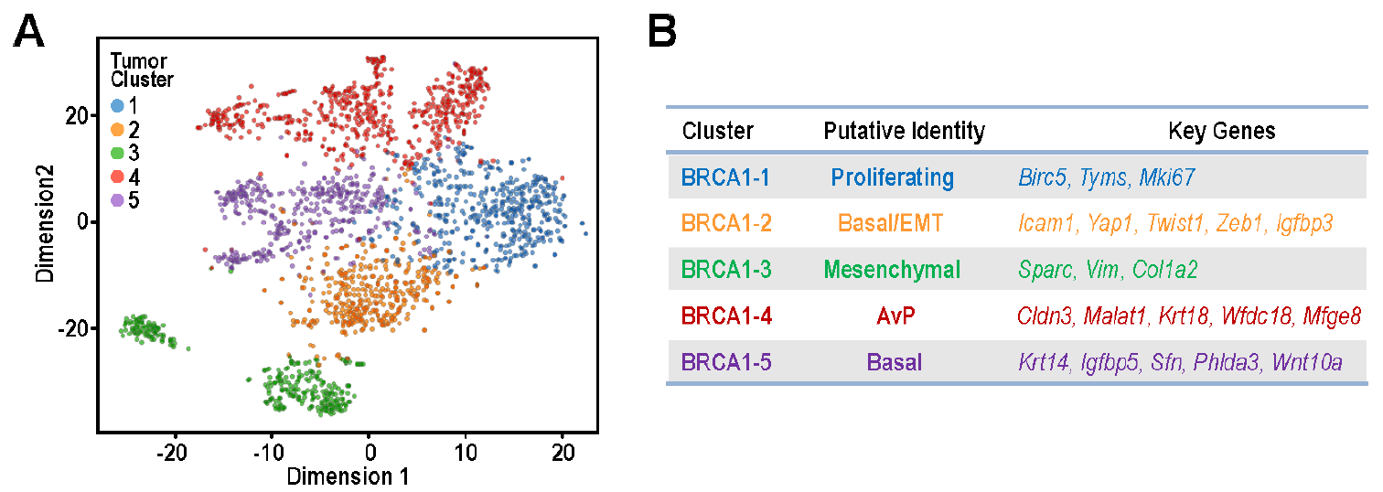
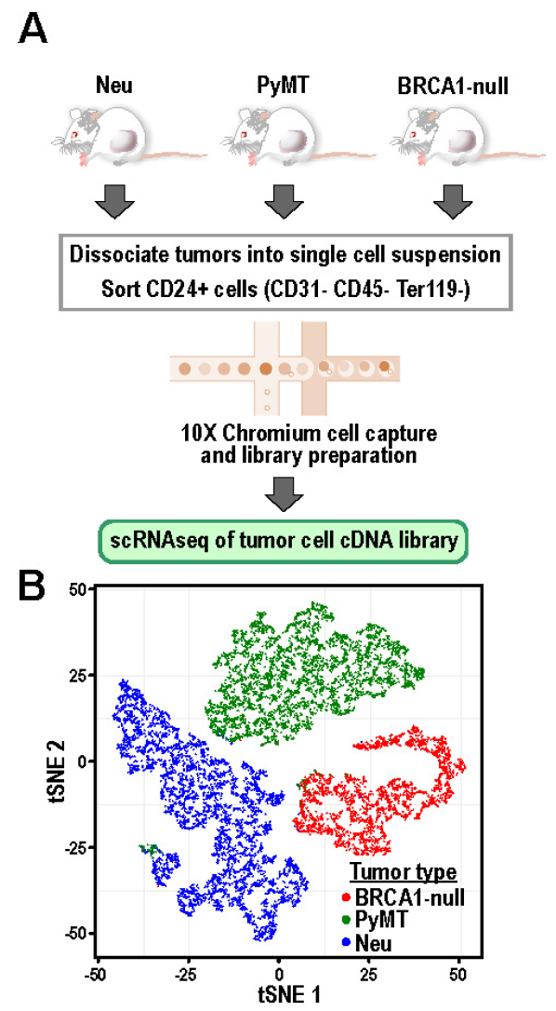
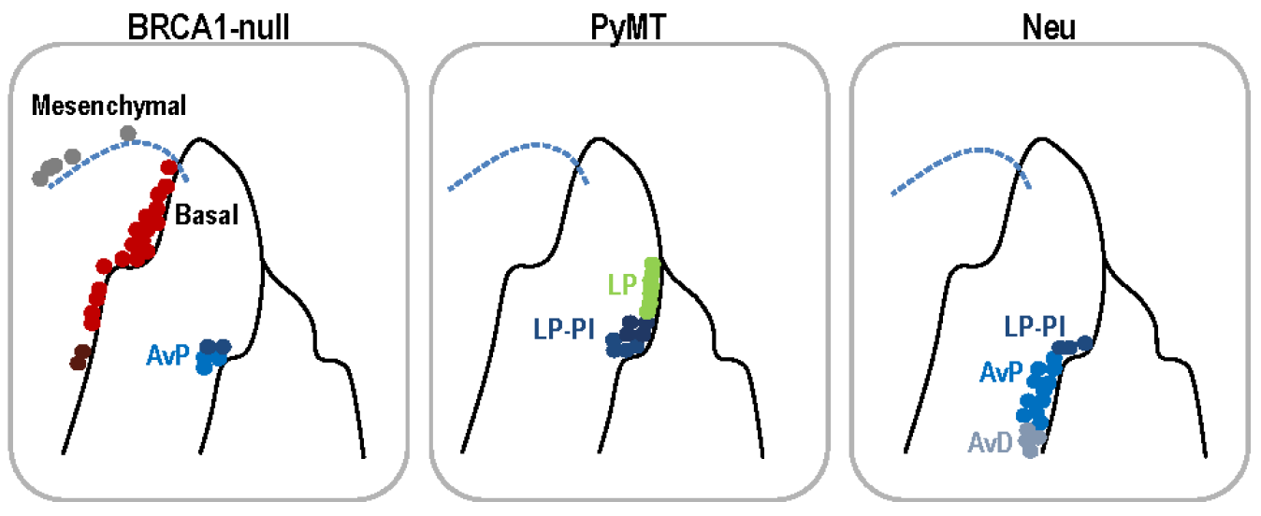
scRNA-seq example #2 – tumour cells
differentiation trajectories of cells
Yeo et al. 2020 eLife

Slide 33
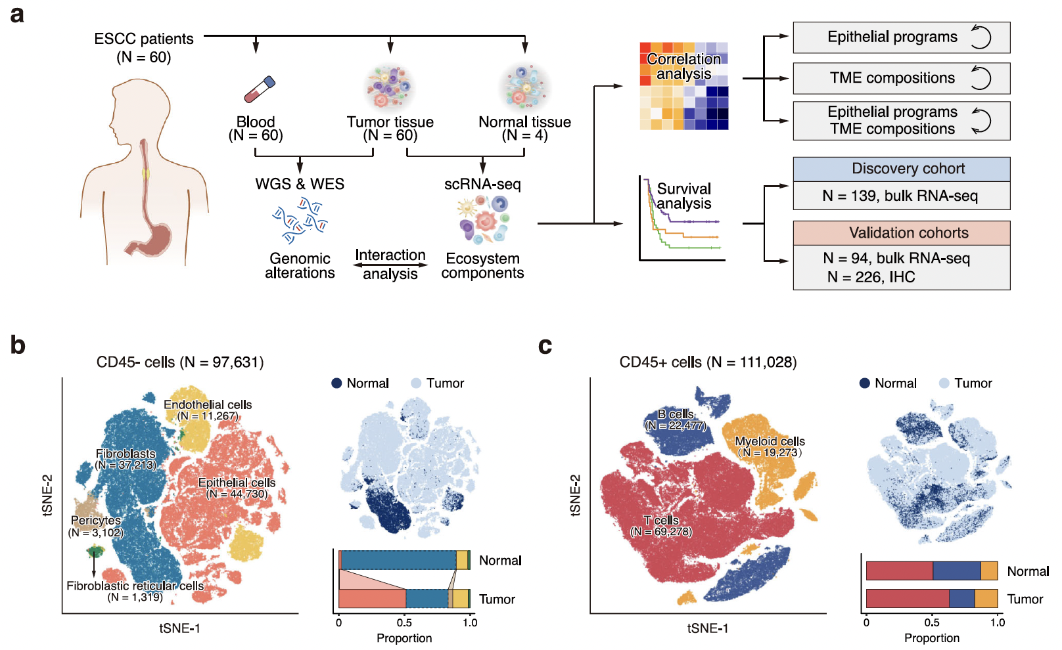
scRNA-seq example #3 – all cells
Zhang et al. 2021 Nature Comms

Slide 34
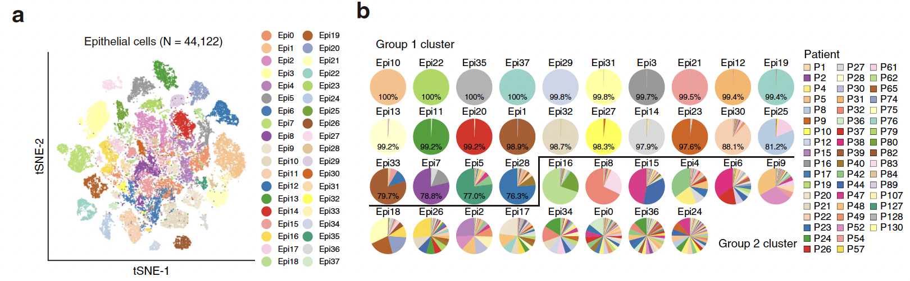
Intra- and inter-tumor heterogeneity of epithelial cells
There is a large degree of intra- and inter-tumour heterogeneity among the epithelial cancer cells between patients

Slide 35
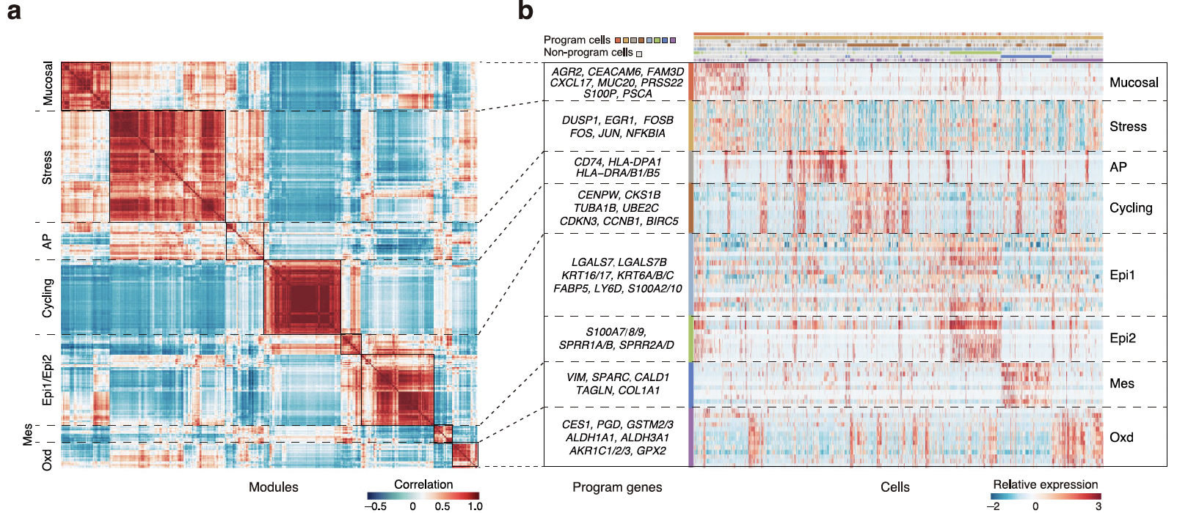
Non-negative matrix factorization to identify distinct gene programmes
Non-negative matrix factorization is a type of unsupervised clustering algorithm that identify clusters that show similar gene expression patterns

Slide 36
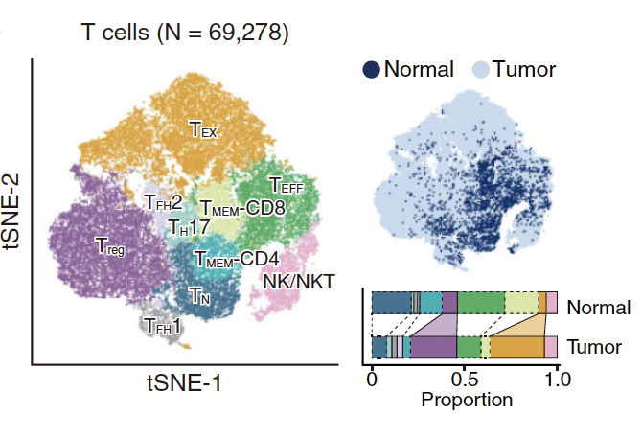
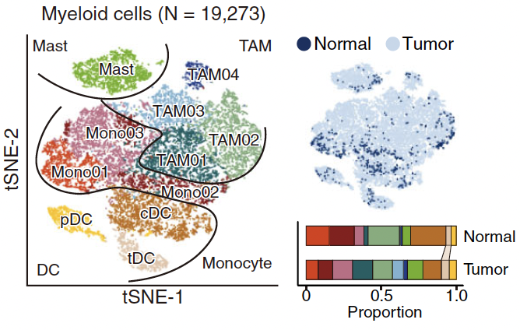
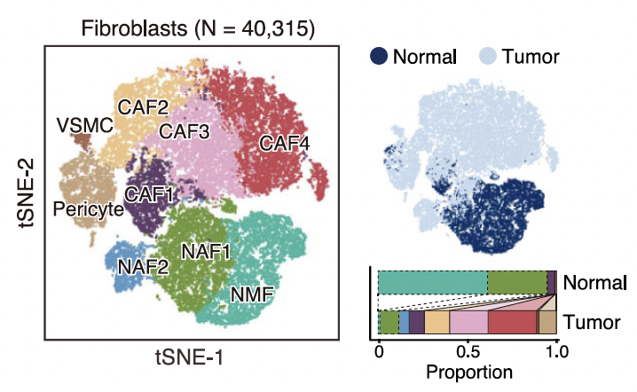
Distinct changes in non-cancer cells between tumour and normal samples
Compared to epithelial cancer cells, non-cancer cells from different tumour samples formed closer clusters with each other
Distinct changes in immune and stroma cell compositions between tumour and normal samples
- e.g., more exhausted CD8+ T cells, regulatory T cells, but reduced CD8+ effector T cells, naïve and memory CD4+ T cells

Slide 37
scRNA-seq
Allow for single cell assessment of individual cells
Identify new cell populations / subpopulations
Study the heterogeneity and evolution of tumour, immune and stromal cells
Problematic preparation and sequencing
Expensive
Optimisation

Slide 38
Suggested reading if interested
Bulk RNA-seq vs. scRNA-seq
Lambrechts D, Wauters E, Boeckx B, Aibar S, Nittner D, Burton O, Bassez A, Decaluwé H, Pircher A, Van den Eynde K, Weynand B, Verbeken E, De Leyn P, Liston A, Vansteenkiste J, Carmeliet P, Aerts S, Thienpont B. Phenotype molding of stromal cells in the lung tumor microenvironment. Nat Med. 2018 Aug;24(8):1277-1289.
https://scrnaseq-course.cog.sanger.ac.uk/website/index.html
Yeo SK, Zhu X, Okamoto T, Hao M, Wang C, Lu P, Lu LJ, Guan JL. Single-cell RNA-sequencing reveals distinct patterns of cell state heterogeneity in mouse models of breast cancer. Elife. 2020 Aug 25;9:e58810.
Zhang X, Peng L, Luo Y, Zhang S, Pu Y, Chen Y, Guo W, Yao J, Shao M, Fan W, Cui Q, Xi Y, Sun Y, Niu X, Zhao X, Chen L, Wang Y, Liu Y, Yang X, Wang C, Zhong C, Tan W, Wang J, Wu C, Lin D. Dissecting esophageal squamous-cell carcinoma ecosystem by single-cell transcriptomic analysis. Nat Commun. 2021 Sep 6;12(1):5291.
Long noncoding RNA
Carlevaro-Fita J, Lanzós A, Feuerbach L, Hong C, Mas-Ponte D, Pedersen JS; PCAWG Drivers and Functional Interpretation Group, Johnson R; PCAWG Consortium. Cancer LncRNA Census reveals evidence for deep functional conservation of long noncoding RNAs in tumorigenesis. Commun Biol. 2020 Feb 5;3(1):56.
Yao, RW., Wang, Y. & Chen, LL. Cellular functions of long noncoding RNAs. Nat Cell Biol 21, 542–551 (2019).

